Slide 1

Flood Prediction Using Machine Learning: Mitigating Disaster Impacts
GUIDE:
MR.M.VENKATESWAR RAO MTech
Assistant Professor
Presented By:
RUKSANA SYED-216C1A6634
G.BHUVANESWARI-216C1A6616
P.SINDHUJA-216C1A6629
G.LASYA-216C1A6611

Slide 2
Abstract
Floods pose significant threats to human life and property. These natural disasters can cause widespread destruction, disrupt critical infrastructure, and displace entire communities. Accurate and timely flood prediction is crucial for implementing effective disaster preparedness and response measures.
Traditional flood prediction models often struggle to capture the intricate complexities of flood dynamics. They may rely on simplistic assumptions or lack the ability to incorporate real-time data from various sources. This limitation can lead to inaccurate forecasts, hindering the ability to mitigate the impacts of floods.
Machine learning (ML) offers promising solutions to address the shortcomings of traditional flood prediction models. By leveraging advanced algorithms and the power of data-driven analysis, ML can enable more accurate and efficient flood predictions. This presentation will explore the application of ML to flood prediction, highlighting its potential to enhance disaster risk management and improve community resilience.

Slide 3

Introduction
1
Floods
2
Machine Learning
Floods are among the most destructive natural disasters, causing widespread damage to communities, infrastructure, and human lives.
Machine learning (ML) has emerged as a powerful tool in the field of flood prediction, offering the potential to enhance the accuracy and efficiency of flood forecasting models.
3
This Presentation
This presentation will examine the use of machine learning in flood prediction, highlighting its advantages and the opportunities it presents for improving disaster risk management and community resilience.

Slide 4
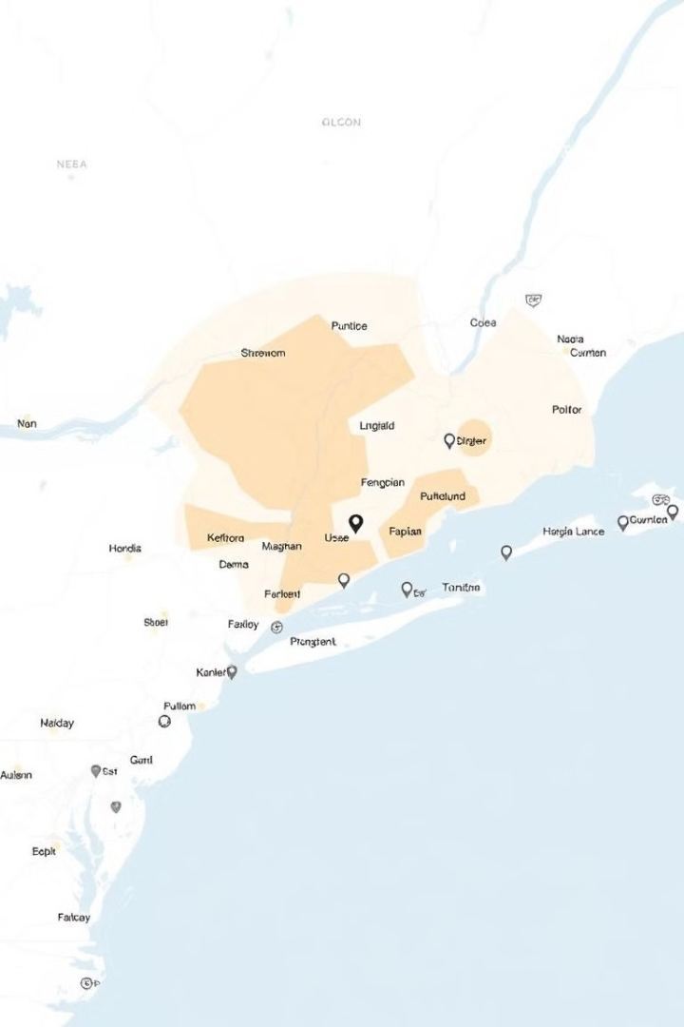
Existing Systems
Traditional Models
Limitations
Existing flood prediction models are often based on physical equations and hydrological data, which can struggle to capture the complex dynamics of flood events.
These traditional models may rely on simplistic assumptions or lack the ability to incorporate real-time data from various sources, leading to inaccurate forecasts and hindering effective disaster preparedness and response.
ML Approaches
Machine learning approaches offer a more robust and adaptable solution, with the potential to enhance the accuracy and reliability of flood prediction models.

Slide 5
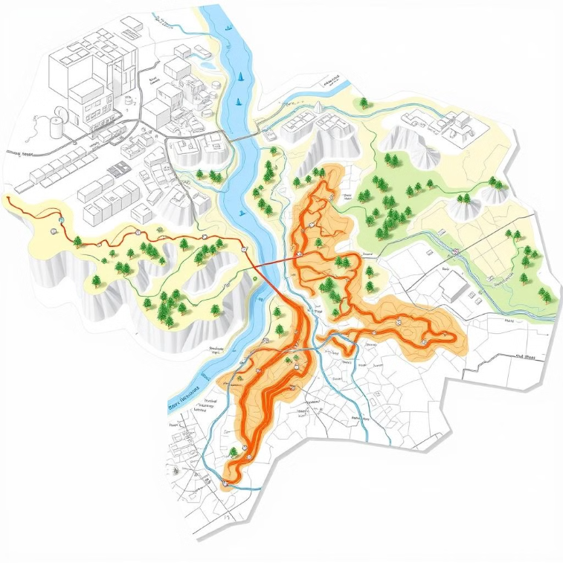
Advantages of Traditional Flood Prediction Models
Traditional flood prediction models, while having limitations, offer valuable baseline data and established methodologies. They provide a foundational understanding of hydrological processes and can be relatively simple to implement, making them useful in areas with limited resources or data availability. These models can be effective in predicting floods based on historical data and well-understood hydrological patterns.

Slide 6
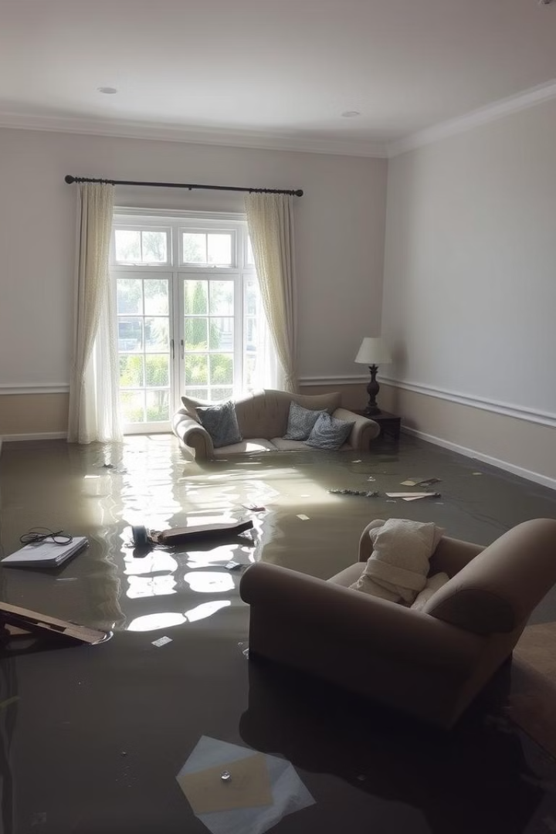



Disadvantages
Limited Accuracy
Time-Consuming
Traditional models often provide inaccurate predictions.
Data processing and prediction take a significant amount of time.
Costly
Development and maintenance of traditional models are expensive.

Slide 7
Applications of Flood Forecasting using Traditional Models
Improved Understanding of Hydrological Processes:
Baseline Data for Calibration and Validation:
These models offer established methodologies and data for validating newer methods.
Traditional models provide insights into the underlying physical mechanisms governing flood events.
Simplified Implementation in Resource-Constrained Areas:
Predictive Capability Based on Historical Data and Patterns:
Traditional models can be easier to implement in regions with limited data availability or computational resources.
Traditional methods can be effective at predicting floods based on historical trends and well-understood hydrological dynamics.

Slide 8
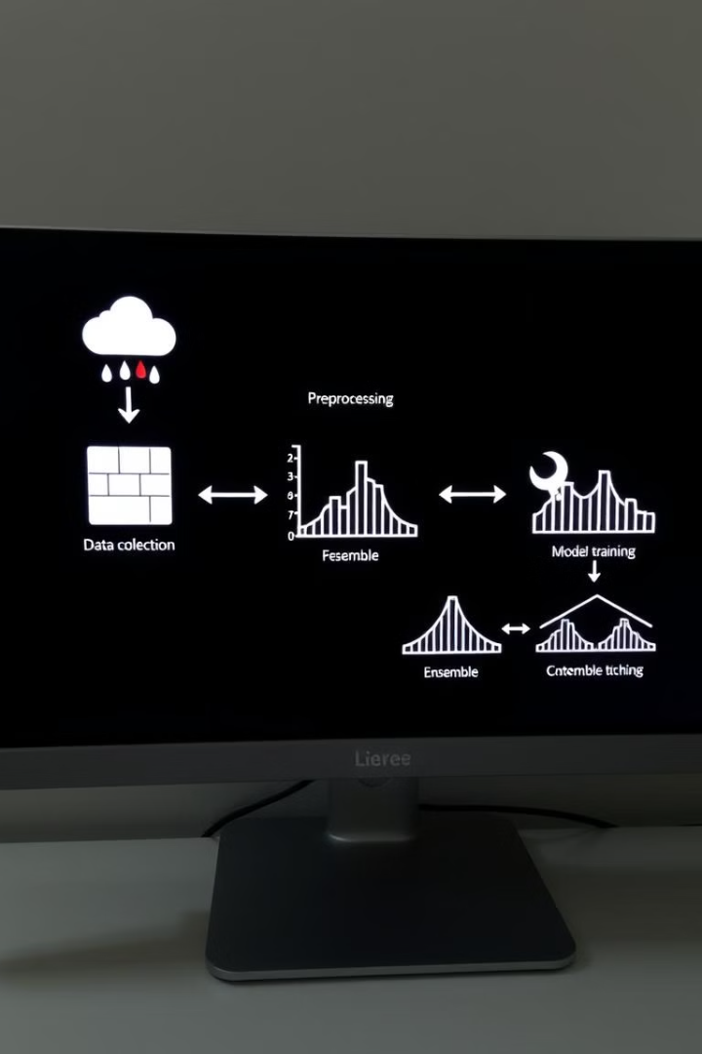
Proposed System
1
Data Collection and Integration.
2
Data Preprocessing and Decomposition.
3
Model Selection and Training.
4
Model Optimisation and Continuous Learning.
5
Hybrid Machine Learning Models and Feature Extraction.
6
Algorithm Ensemble.

Slide 9
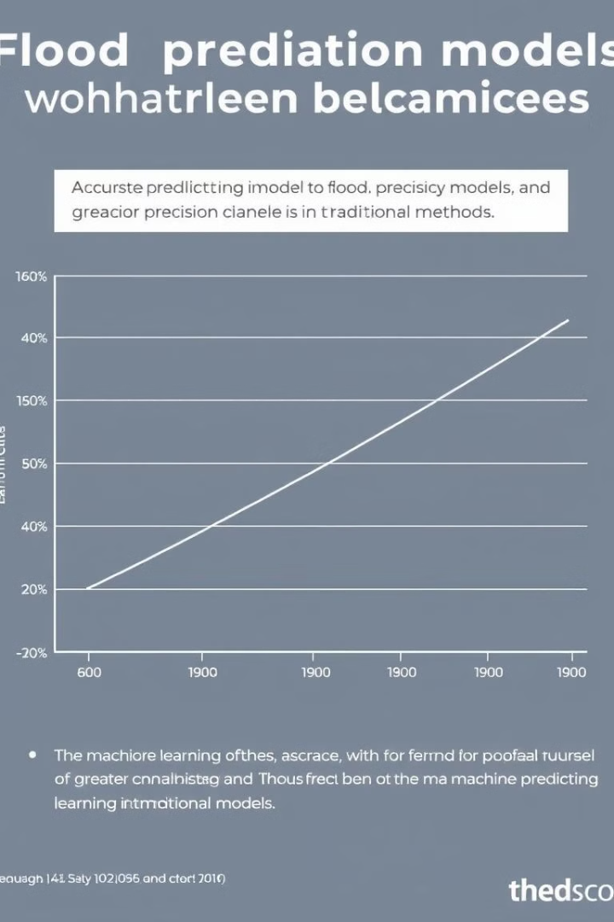



Advantages
Improved Accuracy
ML models offer substantially more accurate predictions than traditional methods.
Faster Prediction
ML algorithms process data significantly faster, leading to quicker predictions.
Cost-Effective
ML models are more efficient to develop and maintain, resulting in lower overall costs.

Slide 10
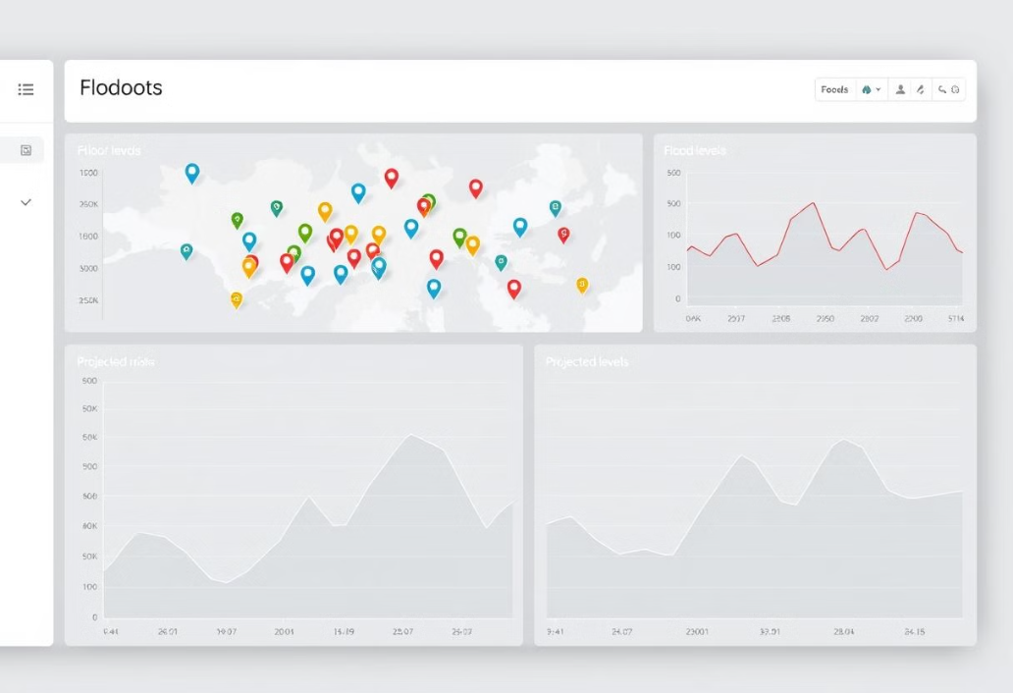
Applications of Flood Forecasting using ML
Improved Accuracy
Early Warning Systems
ML algorithms analyze vast datasets for more accurate flood level predictions.
ML enables timely warning systems, giving communities crucial time to prepare.
Resource Optimization
Integration with Existing Systems
ML optimizes resource allocation for more efficient flood mitigation and response.
ML enhances traditional models using real-time data from various sources.

Slide 11
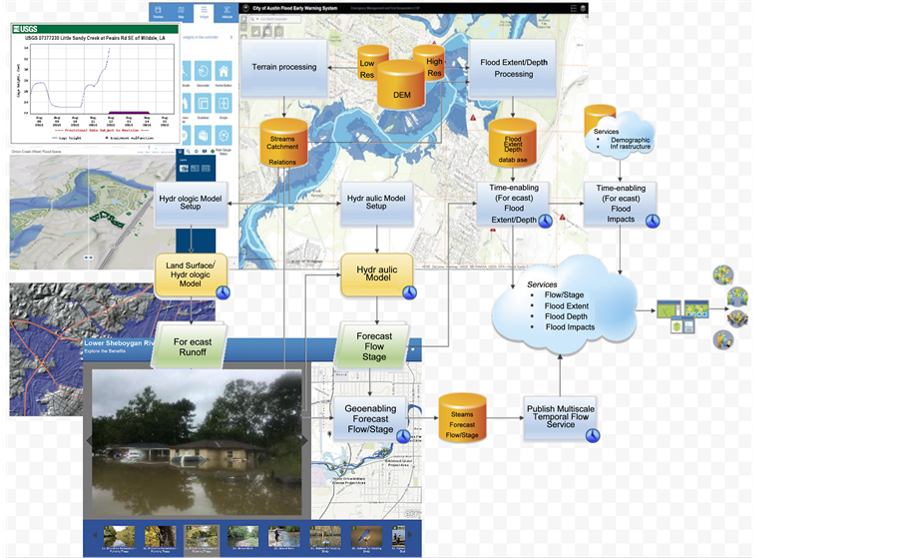
Software Specifications
Hardware Requirements:
System: Intel I-3, I-5, or I-7 Processor
Hard Disk: 500 GB
Floppy Drive: 1.44 MB
Monitor: 14" Colour Monitor
Mouse: Optical Mouse
RAM: 2 GB
Software Requirements:
Operating System: Windows 8, 10 Ultimate, Linux, Mac
Front-End: Python
Coding Language: Python
Software Environment: Anaconda (Jupyter or Spyder)
User Requirements:
Load the application before use.
Provide data (text, audio, image, video) to hide.
Have a master file for embedding data.
Use a stego-key for encryption/decryption.
Functional Requirements:
Outputs: External, Internal, Operational, and Interface Outputs.
User interaction: Understand preferences via a questionnaire.
Input Data: Can be in relational databases, text files, Excel, or XML.

Slide 12
Project Life Cycle
Planning
1
Requirements gathering, feasibility study, project planning
2
Analysis
System analysis, requirements specification, design specification
Design
3
Database design, UI/UX design, system architecture
4
Implementation
Coding, testing, debugging
Testing
5
Unit testing, integration testing, user acceptance testing
6
Deployment
System deployment, user training, go-live
Maintenance
7
Bug fixes, performance tuning, system upgrades

Slide 13
Modules Used in Flood Forecasting
Data Upload: A component designed to accept user input in the form of datasets (e.g., CSV or Excel files) containing historical data such as rainfall, water levels, or weather conditions. This data is the foundation for training and testing the machine learning models.
Dataset Splitting: A functionality that divides the uploaded dataset into two parts: training data (used to train the model) and testing data (used to evaluate model performance). This split ensures that the model generalizes well on unseen data.
KNN Algorithm: It Implements the K-Nearest Neighbors (KNN) algorithm, which predicts flood risk by identifying the closest data points (neighbors) in historical records and determining the majority outcome among them.
Logistic Regression: A statistical model used to predict binary outcomes, such as "flood" or "no flood," based on input features. It calculates probabilities and applies a threshold to classify outcomes.
SVM (Support Vector Machine): A machine learning model that classifies data by finding the best-separating hyperplane in a high-dimensional space. It’s especially useful for handling complex and non-linear relationships in flood prediction.
Decision Tree: A predictive model that uses a tree-like structure to split data into branches based on conditions, ultimately leading to a prediction (e.g., whether a flood will occur).
Random Forest: An ensemble learning technique that creates multiple decision trees and combines their predictions to improve accuracy and reduce errors in flood forecasting.
Visualization Libraries: Tools for creating insightful visualizations of flood predictions and model performance (e.g., Tkinter, Matplotlib, Seaborn).

Slide 14
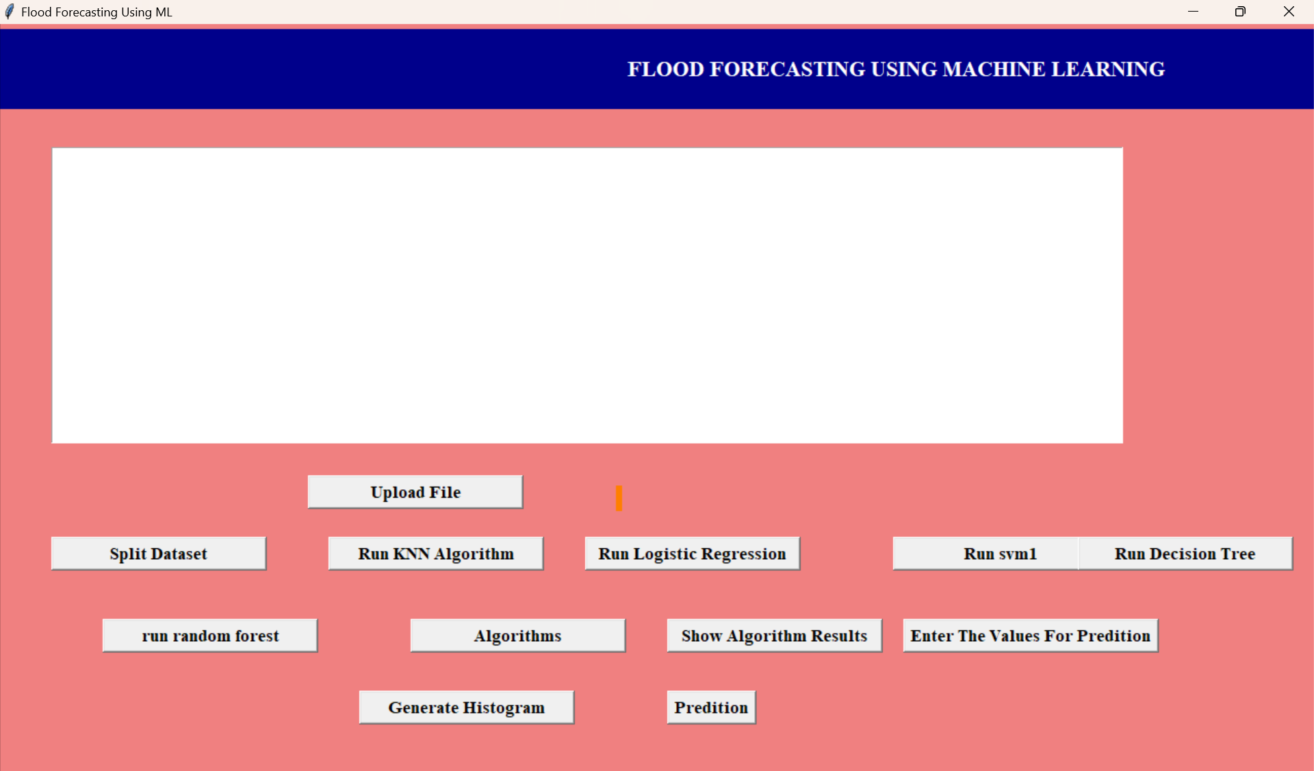
USER INTERFACE

Slide 15
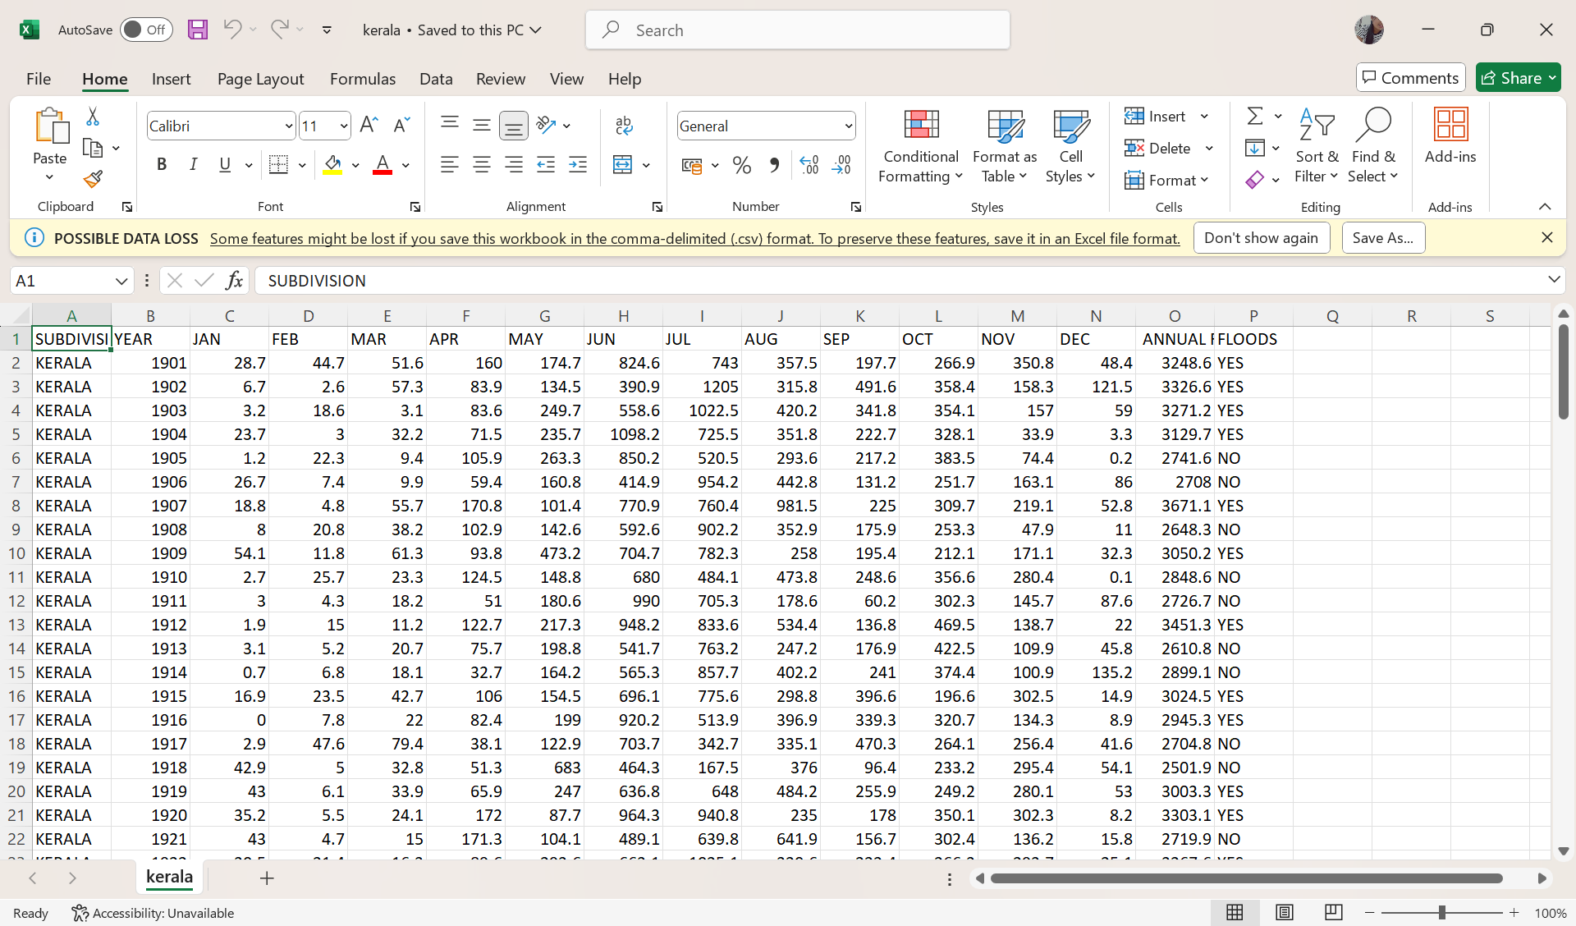
DATASET

Slide 16
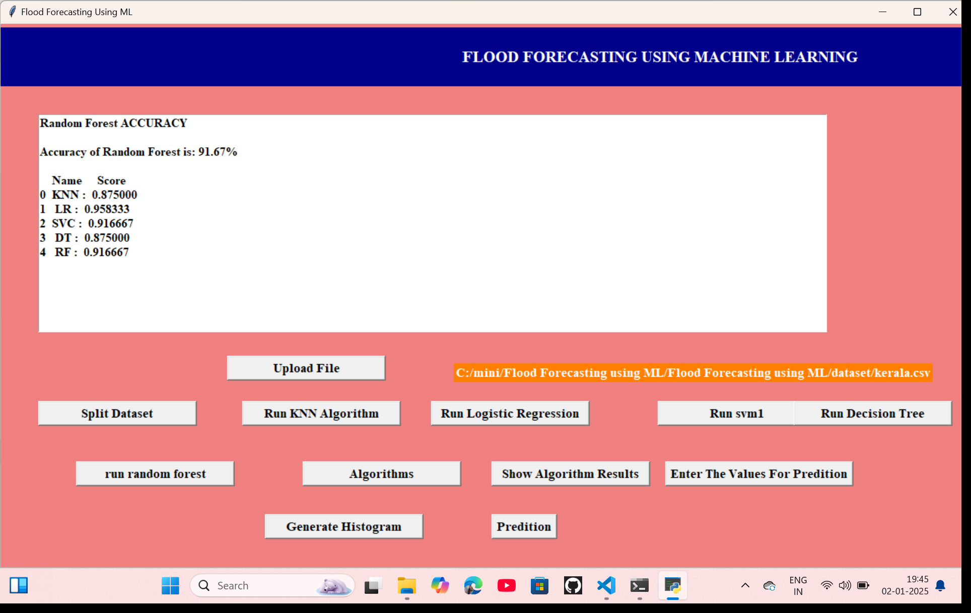
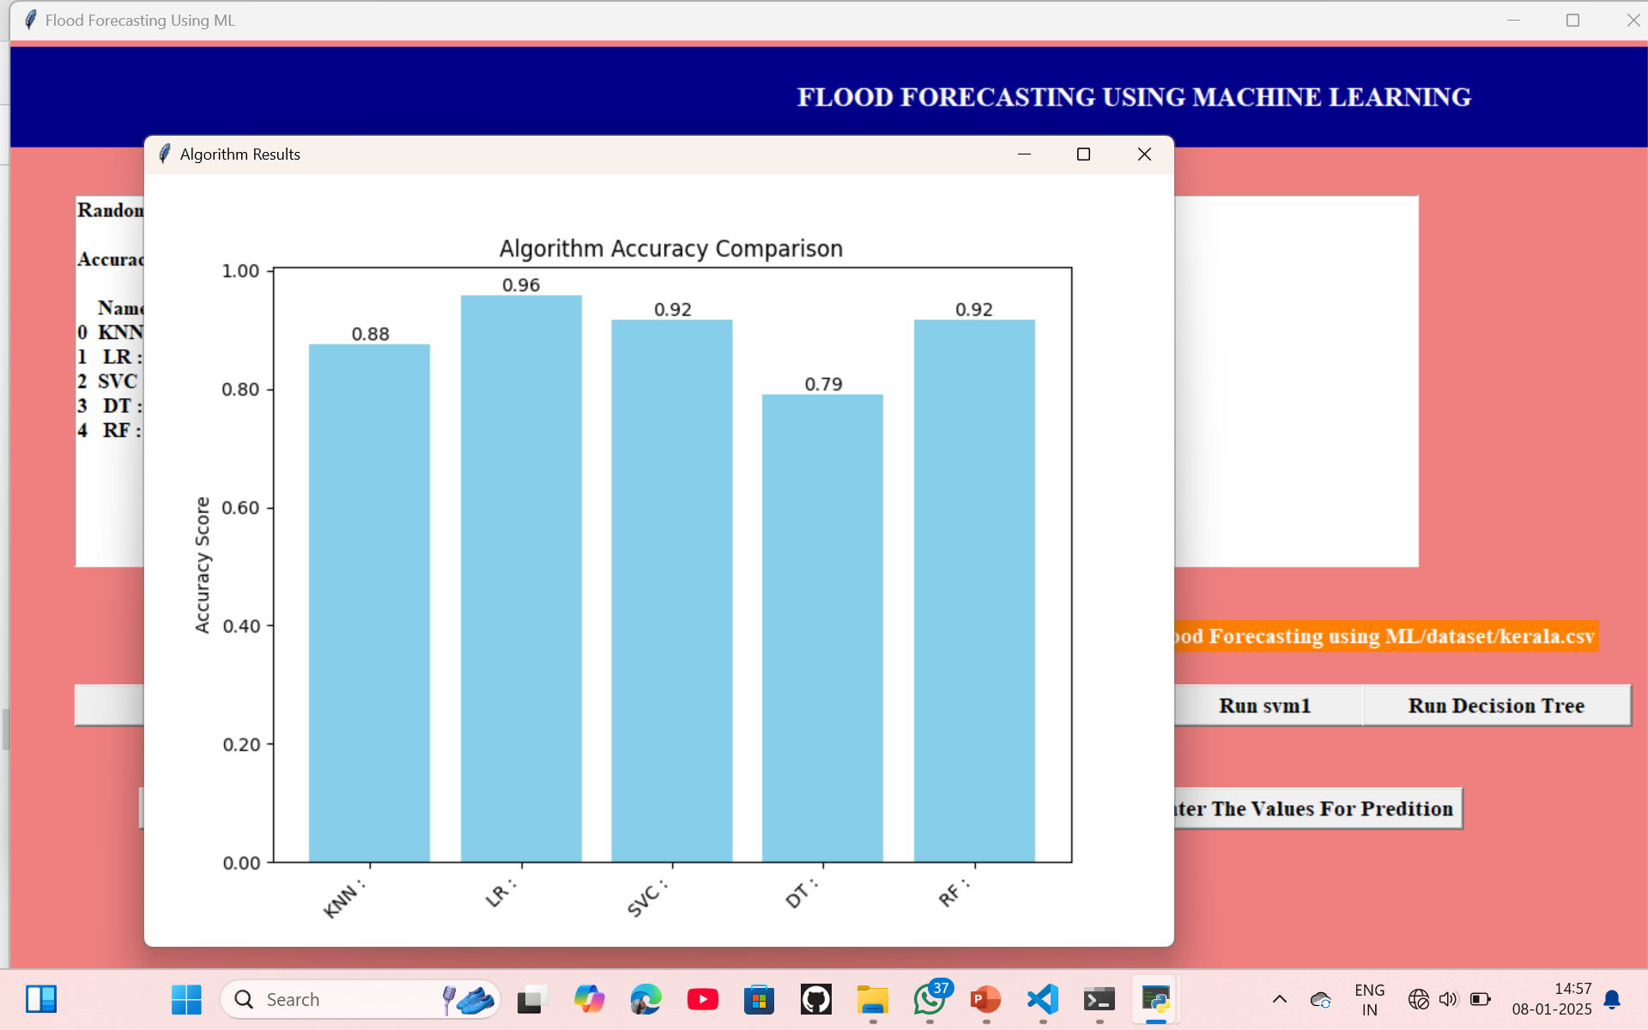
ALGORITHM ACCURACY COMPARISON

Slide 17
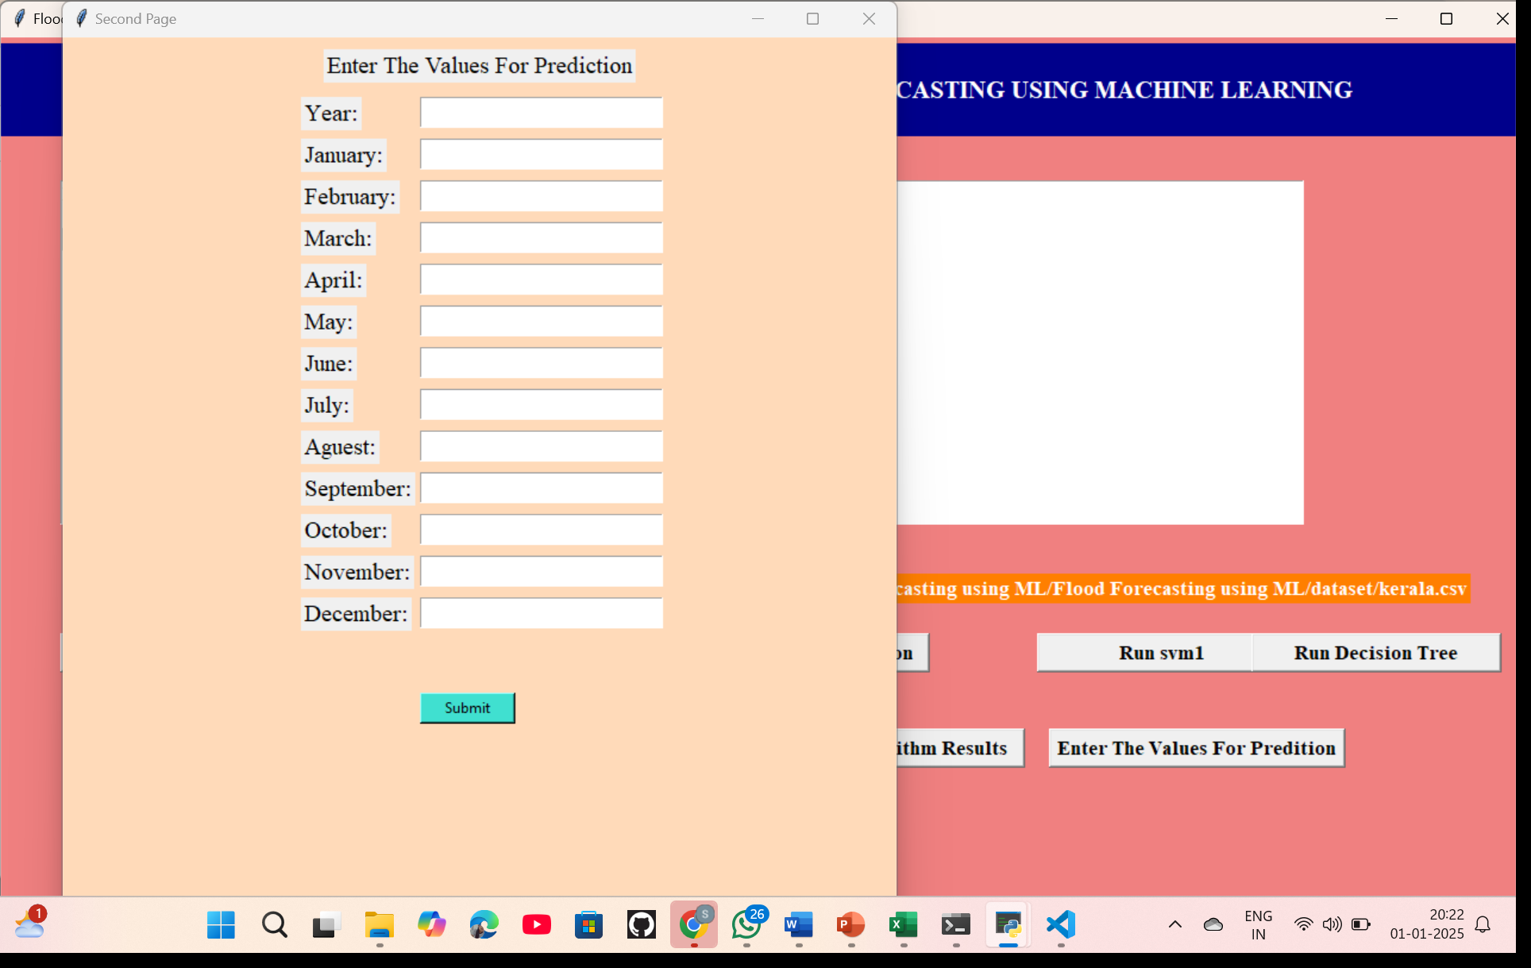
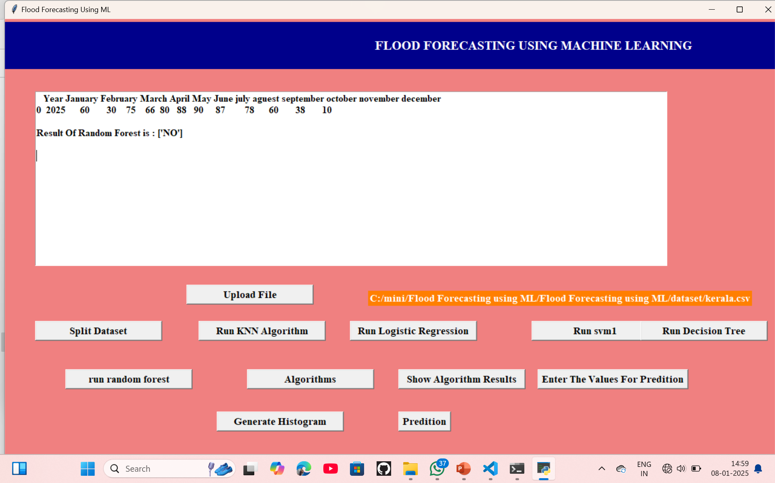
FUTURE PREDICTION OF FLOODS
RESULT

Slide 18
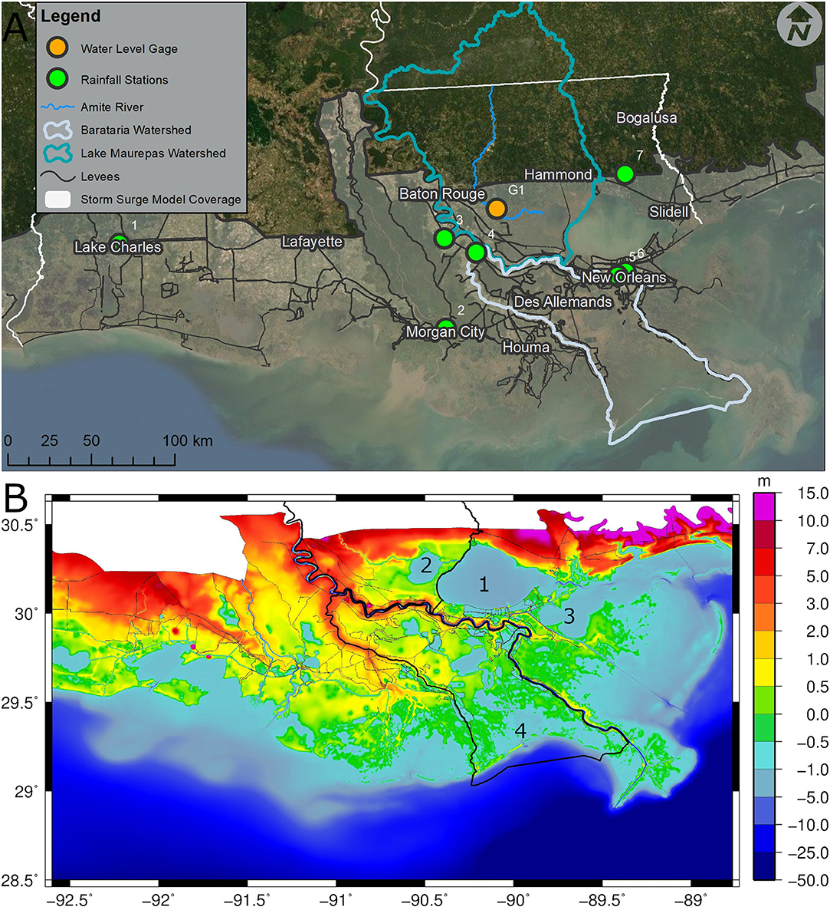
Future Scope
The future scope of flood forecasting using Machine Learning (ML) holds tremendous promise for enhancing prediction accuracy, timeliness, and adaptability in managing flood risks. Integrating real-time data from remote sensing technologies, IoT devices, and satellite imagery will allow for more precise, localized, and timely flood forecasts. The development of hybrid ML models combining various techniques like deep learning and decision trees will improve accuracy by capturing complex environmental patterns. As flood prediction systems evolve, they will become an integral part of early warning systems, offering real-time alerts and personalized notifications based on specific regions and individual preferences. Additionally, incorporating climate change models into flood forecasting will enable more robust long-term predictions, allowing for better preparedness for extreme weather events. Integration with smart city infrastructure and automated decision-making will enable more efficient risk management and infrastructure planning, ensuring that communities are better equipped to handle future flood events.
.
.
.

Slide 19
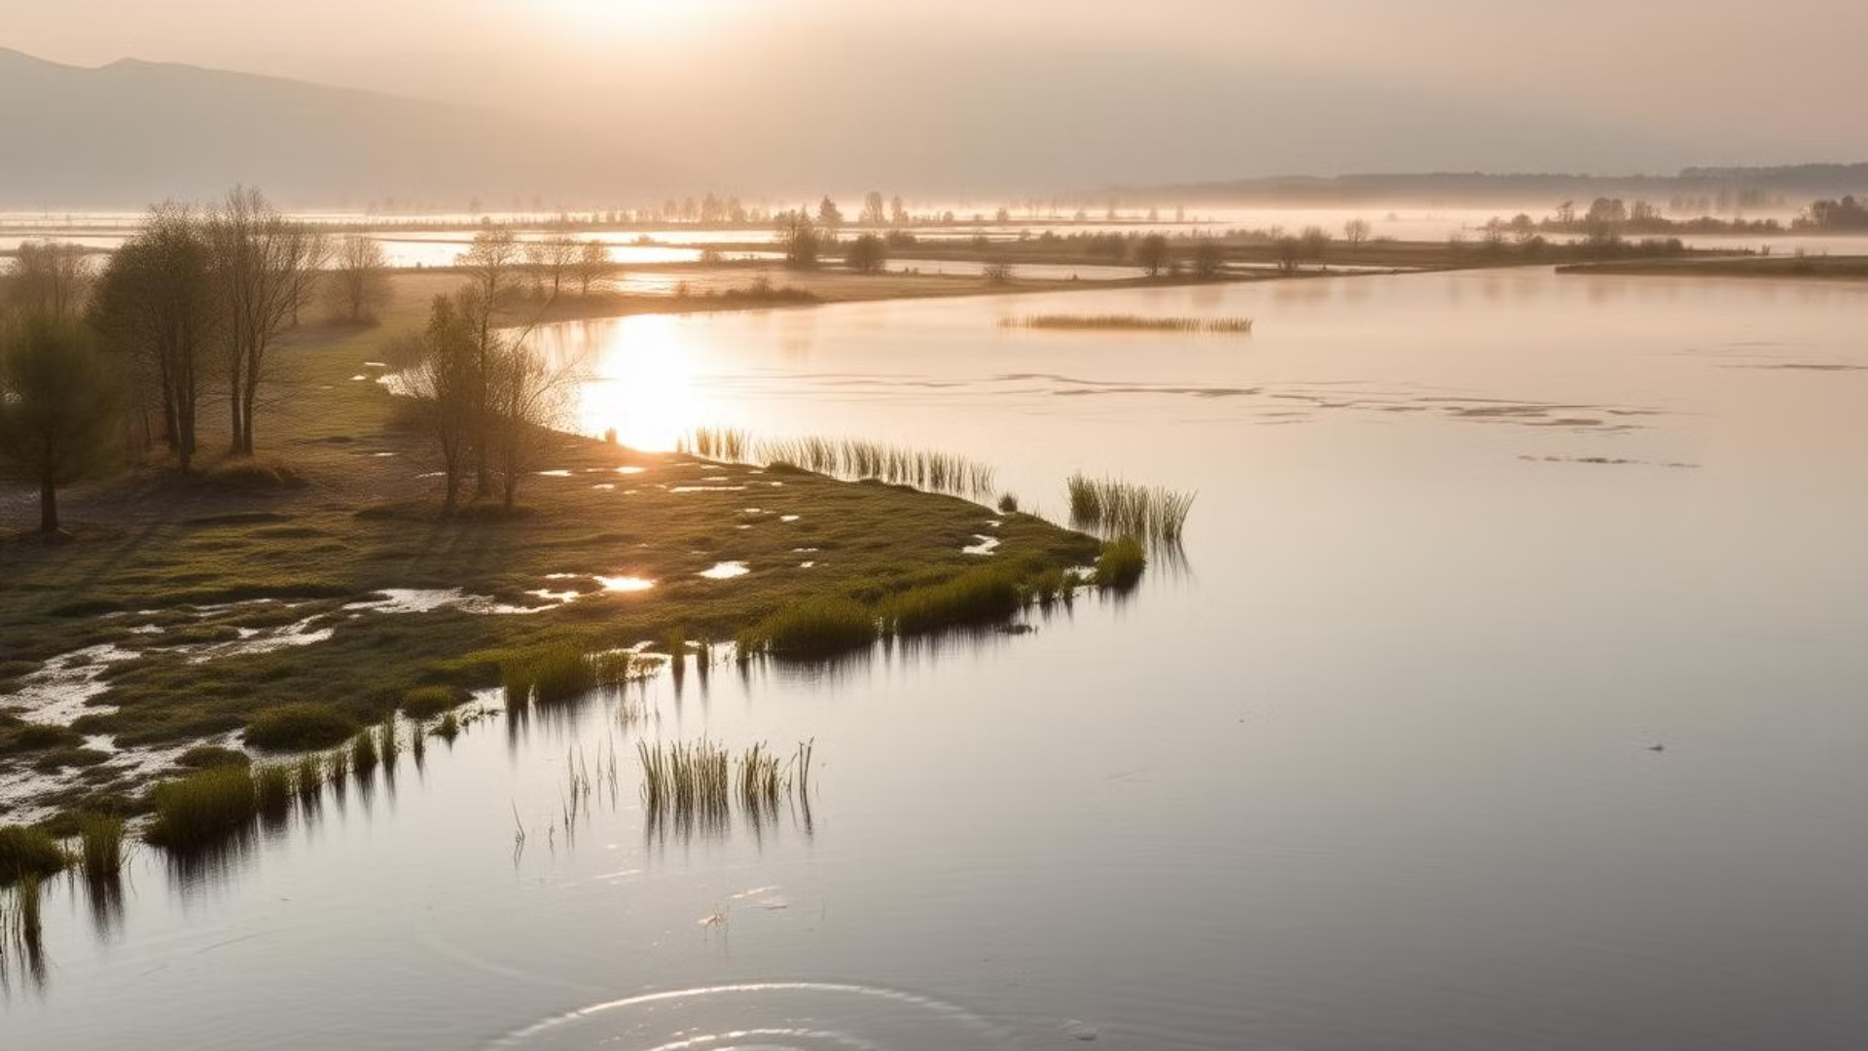
Conclusion
This presentation has outlined a machine learning-based flood forecasting system designed to improve disaster preparedness and response. By leveraging advanced algorithms and readily available technologies, our proposed system offers a cost-effective and user-friendly solution for predicting and mitigating flood risks, enabling more timely and effective disaster management and saving lives.

Slide 20

THANK YOU…..

